Slide 1

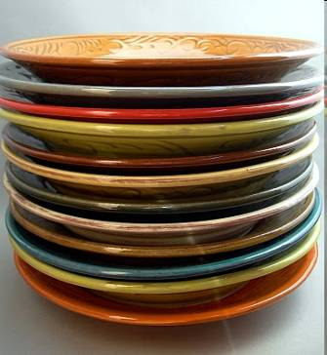
Lecture #5
Stacks
Queues

Slide 2
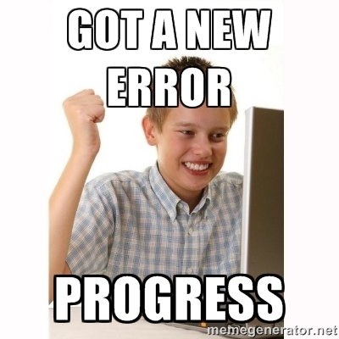

Slide 3



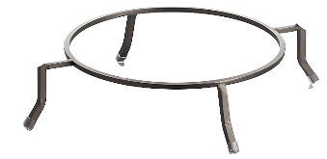
Stacks What’s the big picture?
A stack is a data structure that resembles a stack of plates at a buffet.
Just like a stack of plates, the last plate/value you add is at the top of the stack, and thus the first to be removed.
10
8
10
8
10
Uses:
Use stacks to find a path through a maze, “undo” in a word processor, and evaluate math expressions.
8
10
10
The last-added/first-removed aspect of stacks can help solve many hard problems!
Notes:
Just like a stack of plates, you can only access the top plate/value, and every plate/value you add must go on the top.

Slide 4
The Stack: A Useful ADT
A stack is an ADT that holds a collection of items (like ints) where the elements are always added to one end.
Just like a stack of plates, the last item pushed onto the top of a stack is the first item to be removed.
Stack operations:
put something on top of the stack (PUSH)
remove the top item (POP)
look at the top item, without removing it
check to see if the stack is empty
We can have a stack of any type of variable we like:
ints, Squares, floats, strings, etc.

Slide 5
The Stack
Note: The stack is called a Last-In-First-Out data structure.
Can you figure out why?
I can…
Push 5 on the stack.
last in
first out
Push -3 on the stack.
Push 9 on the stack.
9
Pop the top of the stack.
4
-3
Look at the stack’s top value.
-3
5
Push 4 on the stack.
5
Pop the top of the stack
Pop the top of the stack
Look at the stack’s top value.
Pop the top of the stack
Note: You can only access the top item of the stack, since the other items are covered.

Slide 6
Stacks
class Stack // stack of ints
{
public:
Stack(); // c’tor
void push(int i);
int pop();
bool is_empty(void);
int peek_top();
private:
...
};
int main(void)
{
Stack is;
is.push(10);
is.push(20);
...
}
Answer:
How about an array and a counter variable to track where the top of the stack is?
Question: What type of data structure can we use to implement our stack?

Slide 7
Implementing a Stack
To initialize our stack, we’ll specify that the first item should go in the 0th slot of the array.
const int SIZE = 100;
class Stack
{
public:
Stack() { }
void push(int val) {
}
int pop() {
}
...
private:
};
Let’s make sure we never over-fill (overflow) our stack!
For this simple example, let’s just exit if this happens.
Place our new value in the next open slot of the array… m_top specifies where that is!
Update the location where our next item should be placed in the array.
m_top = 0;
Since m_top points to where our next item will be pushed…
Let’s decrement it to point it to where the current top item is!
if (m_top >= SIZE) exit(-1); // overflow!
We can’t pop an item from our stack if it’s empty! Terminate our program!
m_stack[m_top] = val;
m_top += 1;
Extract the value from the top of the stack and return it to the user.
Let’s use an array to hold our stack items.
This stack may hold a maximum of 100 items.
if (m_top == 0) exit(-1); // underflow
m_top -= 1;
We’ll use a simple int to keep track of where the next item should be added to the stack.
return m_stack[m_top];
int m_stack[SIZE];
int m_top;

Slide 8
Stacks
The first item we push will be placed in m_stack[0].
int main(void)
{
Stack is;
int a;
is.push(5);
is.push(10);
a = is.pop();
cout << a;
is.push(7);
}
const int SIZE = 100;
class Stack
{
public:
Stack() { m_top = 0; }
void push(int val) {
if (m_top >= SIZE) exit(-1); // overflow
m_stack[m_top] = val;
m_top += 1;
}
int pop() {
if (m_top == 0) exit(-1); // underflow
m_top -= 1;
return m_stack[m_top];
}
...
private:
int m_stack[SIZE];
int m_top;
};
Currently, our m_top points to the next open slot in the stack…
But we want to return the top item already pushed on the stack.
So first we must decrement our m_top variable…
The second item we push will be placed in slot #1 of our stack.
1 >= 100?
1 >= 100?
0 >= 100?
m_stack[0] = 5
m_stack[1] = 7
m_stack[1] = 10
7
10
5
2 == 0??
return m_stack[1]
So we return 10
is
m_top
0
1
2
2
1
m_stack
0
1
2
...
99
5
7
10
…
7
10
5
a
10

Slide 9
Stacks
Always Remember:
When we push, we:
Store the new item in m_stack[m_top]
Post-increment our m_top variable
(post means we do the increment after storing)
const int SIZE = 100;
class Stack
{
public:
Stack() { m_top = 0; }
void push(int val) {
if (m_top >= SIZE) exit(-1); // overflow
m_stack[m_top] = val;
m_top += 1;
}
int pop() {
if (m_top == 0) exit(-1); // underflow
m_top -= 1;
return m_stack[m_top];
}
...
private:
int m_stack[SIZE];
int m_top;
};
Always Remember:
When we pop, we:
Pre-decrement our m_top variable
Return the item in m_stack[m_top]
(pre means we do the decrement before returning)

Slide 10
Stacks
And as with cin and cout, you can remove the std:: prefix if you add a using namespace std; command!
Here’s the syntax to define a stack:
std::stack<type> variableName;
For example:
std::stack<string> stackOfStrings;
std::stack<double> stackOfDoubles;
Stacks are so popular that the C++ people actually wrote one for you. It’s in the Standard Template Library (STL)!
#include <iostream>
#include <stack> // required!
int main()
{
std::stack<int> istack; // stack of ints
istack.push(10); // add item to top
istack.push(20);
cout << istack.top(); // get top value
istack.pop(); // kill top value
if (istack.empty() == false)
cout << istack.size();
}
using namespace std;
So to get the top item’s value, before popping it, use the top() method!
stack<int> istack; // stack of ints
Note: The STL pop() command simply throws away the top item from the stack… but it doesn’t return it.

Slide 11
Stack Challenge
Show the resulting stack after the following program runs:
#include <iostream>
#include <stack>
using namespace std;
int main()
{
stack<int> istack; // stack of ints
istack.push(6);
for (int i=0;i<2;i++)
{
int n = istack.top();
istack.pop();
istack.push(i);
istack.push(n*2);
}
}

Slide 12
Stack Challenge
Show the resulting stack after the following program runs:
#include <iostream>
#include <stack>
using namespace std;
int main()
{
stack<int> istack; // stack of ints
istack.push(6);
for (int i=0;i<2;i++)
{
int n = istack.top();
istack.pop();
istack.push(i);
istack.push(n*2);
}
}
i
0
1
n
24
12
12
1
6
6
0

Slide 13
Common Uses for Stacks
Stacks are one of the most USEFUL data structures in Computer Science.
They can be used for:
Storing undo items for your word processor
The last item you typed is the first to be undone!
Evaluating mathematical expressions
5 + 6 * 3 → 23
Converting from infix expressions to postfix expressions
A + B → A B +
Solving mazes
In fact – they’re so fundamental to CS that they’re built into EVERY SINGLE CPU in existence!

Slide 14

A Stack… in your CPU!
Did you know that every CPU has a built-in stack used to hold local variables and function parameters?
When you pass a value to a function, the CPU pushes that value onto a stack in the computer’s memory.
void bar(int b)
{
cout << b << endl;
}
void foo(int a)
{
cout << a << endl;
bar(a*2);
}
int main(void)
{
int x = 5;
foo( x );
}
When you pass a value to a function, the CPU pushes that value onto a stack in the computer’s memory.
When a function returns, its variables and parameters are popped off the stack and go away.
Local variables are stored on the computer’s built-in stack!
… when your function returns, the values are popped off the stack and go away.
10
Output:
b
10
5
a
Every time you declare a local variable, your program pushes it on the PC’s stack automatically!
5
10
x
5
5

Slide 15
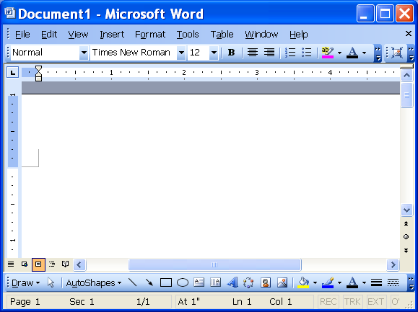


Undo!
When the user hits the undo button…
So how does the UNDO feature of your favorite word processor work?
Carey
is
so
cool
not
so
so
The word processor pops the top item off the stack and removes it from the document!
It uses a stack, of course!
Every time you type a new word, it’s added to the stack!
Every time you cut-and-paste an image into your doc, it’s added to the stack!
“so” → “not”
“so” → “not”
In this way, the word processor can track the last X things that you did and properly undo them!
img5.jpg
img5.jpg
“cool”
“so”
And even when you delete text or pictures, this is tracked on a stack!
“is”
“Carey”
undo stack

Slide 16
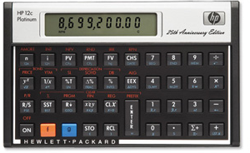
Postfix Expression Evaluation
Most people are used to infix notation, where the operator is in-between the two operands, e.g.: A + B
As we’ll see, postfix expressions have no such ambiguity!
Postfix notation is another way to write algebraic expressions – here the operator follows the operands: A B +
Infix
Postfix
Here are some infix expressions and their postfix equivalents:
If you’ve ever used an HP calculator, you’ve used postfix notation!
15 + 6
15 6 +
Is that (5+10) * 3
or
5 + (10 * 3)
To understand infix expressions, the computer has to be equipped with precedence rules!
9 – 4
9 4 -
(15 + 6) * 5
15 6 + 5 *
7 * 6 + 5
7 6 * 5 +
3 + (4 * 5)
3 4 5 * +
Postfix expressions are easier for a computer to compute than infix expressions, because they’re unambiguous.
Ambiguous infix expression example: 5 + 10 * 3

Slide 17
Postfix Evaluation Algorithm
Inputs: postfix expression string
Output: number representing answer
Private data: a stack
7 6 * 5 +
v1 = 7
v2 = 6
Start with the left-most token.
If the token is a number:
Push it onto the stack
Else if the token is an operator:
Pop the top value into a variable called v2, and the second-to-top value into v1.
Apply operator to v1 and v2 (e.g., v1 / v2)
Push the result of the operation on the stack
If there are more tokens, advance to the next token and go back to step #2
v1 = 42
v2 = 5
temp = 7*6 = 42
temp = 42+5 = 47
6
5
42
47
7
… // we’ll see this in a bit!
5. After all tokens have been processed, the top # on the stack is the answer!

Slide 18
Class Challenge
Given the following postfix expression: 6 8 2 / 3 * -
Show the contents of the stack *after* the 3 has been processed by our postfix evaluation algorithm.
Reminder:
Start with the left-most token.
If the token is a number:
Push it onto the stack
If the token is an operator:
Pop the top value into a variable called v2, and the second-to-top value into v1.
Apply operator to the two #s (e.g., v1 / v2)
Push the result of the operation on the stack
If there are more tokens, advance to the next token and go back to step #2
After all tokens have been processed, the top # on the stack is the answer!
Notes:
Add 6 to stack
Add 8 to stack
Add 2 to stack
Pop 2 into v2, pop 8 into v1, do 8/2 = 4, push 4 onto stack
Push 3 onto stack
Stack looks like:
3
4
6

Slide 19
Infix to Postfix Conversion
Since people are more used to infix notation…
You can let the user type in an infix expression…
And then convert it into a postfix expression.
Finally, you can use the postfix evaluation alg (that we just learned) to compute the value of the expression.
Stacks can also be used to convert infix expressions to postfix expressions:
For example,
From: (3 + 5) * (4 + 3 / 2) – 5
To: 3 5 + 4 3 2 / + * 5 –
Or
From: 3 + 6 * 7 * 8 – 3
To: 3 6 7 * 8 * + 3 -

Slide 20
Infix to Postfix Conversion
Inputs: Infix string
Output: postfix string (initially empty)
Private data: a stack
1. Begin at left-most Infix token.
2. If it’s a #, append it to end of postfix string followed by a space
3. If its a “(“, push it onto the stack.
4. If it’s an operator and the stack is empty:
a. Push the operator on the stack.
5. If it’s an operator and the stack is NOT empty:
a. Pop all operators with greater or equal precedence off the stack and append them on the postfix string.
b. Stop when you reach an operator with lower precedence or a (.
c. Push the new operator on the stack.
6. If you encounter a “)”, pop operators off the stack and append them onto the postfix string until you pop a matching “(“.
7. Advance to next token and GOTO #2
8. When all infix tokens are gone, pop each operator and append it } to the postfix string.

Slide 21
Solving a Maze with a Stack!
We can also use a stack to determine if a maze is solvable:
0 1 2 3 4 5 6 7
0
1
2
3
4
5
6
7
Start
(1,1)
Finish
(6,6)
X

Slide 22
Solving a Maze with a Stack!
Inputs: 10x10 Maze in a 2D array,
Starting point (sx,sy)
Ending point (ex,ey)
Output: TRUE if the maze can be solved, FALSE otherwise
Private data: a stack of points
class Stack
{
public:
Stack(); // c’tor
void push(Point &p);
Point pop(); ...
private:
...
};
class Point
{
public:
Point(int x, int y);
int getx() const;
int gety() const;
private:
int m_x, m_y;
};

Slide 23
Solving a Maze with a Stack!
sx,sy = 1,1
0 1 2 3 4 5 6 7
1. PUSH starting point onto the stack.
2. Mark the starting point as “discovered.”
3. While the stack is not empty:
A. POP the top point off the stack into a variable.
B. If we’re at the endpoint, DONE! Otherwise…
C. If slot to the WEST is open & is undiscovered
Mark (curx-1,cury) as “discovered”
PUSH (curx-1,cury) on stack.
D. If slot to the EAST is open & is undiscovered
Mark (curx+1,cury) as “discovered”
PUSH (curx+1,cury) on stack.
E. If slot to the NORTH is open & is undiscovered
Mark (curx,cury-1) as “discovered”
PUSH (curx,cury-1) on stack.
F. If slot to the SOUTH is open & is undiscovered
Mark (curx,cury+1) as “discovered”
PUSH (curx,cury+1) on stack.
4. If the stack is empty and we haven’t reached our goal position, then the maze is unsolvable.
?
0
1
2
3
4
5
6
7
?
#
?
#
?
#
// Use the stack to explore the maze
// (we’ll see how in a bit)
x
1,1 == 6,6?
Not yet!
To do this, we can put a special value in the array at this location which indicates we’ve “visited” it.
1 , 2
2 , 1
1 , 1
cur = 1,1

Slide 24
Solving a Maze with a Stack!
0 1 2 3 4 5 6 7
1. PUSH starting point onto the stack.
2. Mark the starting point as “discovered.”
3. While the stack is not empty:
A. POP the top point off the stack into a variable.
B. If we’re at the endpoint, DONE! Otherwise…
C. If slot to the WEST is open & is undiscovered
Mark (curx-1,cury) as “discovered”
PUSH (curx-1,cury) on stack.
D. If slot to the EAST is open & is undiscovered
Mark (curx+1,cury) as “discovered”
PUSH (curx+1,cury) on stack.
E. If slot to the NORTH is open & is undiscovered
Mark (curx,cury-1) as “discovered”
PUSH (curx,cury-1) on stack.
F. If slot to the SOUTH is open & is undiscovered
Mark (curx,cury+1) as “discovered”
PUSH (curx,cury+1) on stack.
4. If the stack is empty and we haven’t reached our goal position, then the maze is unsolvable.
0
1
2
3
4
5
6
7
?
#
#
?
#
?
?
#
x
1,2 == 6,6?
Not yet!
1 , 3
1 , 2
2 , 1
cur = 1,2

Slide 25
Solving a Maze with a Stack!
0 1 2 3 4 5 6 7
1. PUSH starting point onto the stack.
2. Mark the starting point as “discovered.”
3. While the stack is not empty:
A. POP the top point off the stack into a variable.
B. If we’re at the endpoint, DONE! Otherwise…
C. If slot to the WEST is open & is undiscovered
Mark (curx-1,cury) as “discovered”
PUSH (curx-1,cury) on stack.
D. If slot to the EAST is open & is undiscovered
Mark (curx+1,cury) as “discovered”
PUSH (curx+1,cury) on stack.
E. If slot to the NORTH is open & is undiscovered
Mark (curx,cury-1) as “discovered”
PUSH (curx,cury-1) on stack.
F. If slot to the SOUTH is open & is undiscovered
Mark (curx,cury+1) as “discovered”
PUSH (curx,cury+1) on stack.
4. If the stack is empty and we haven’t reached our goal position, then the maze is unsolvable.
0
1
2
3
4
5
6
7
#
#
?
#
?
#
?
?
x
1,3 == 6,6?
Not yet!
1 , 3
2 , 1
cur = 1,3

Slide 26
Solving a Maze with a Stack!
0 1 2 3 4 5 6 7
1. PUSH starting point onto the stack.
2. Mark the starting point as “discovered.”
3. While the stack is not empty:
A. POP the top point off the stack into a variable.
B. If we’re at the endpoint, DONE! Otherwise…
C. If slot to the WEST is open & is undiscovered
Mark (curx-1,cury) as “discovered”
PUSH (curx-1,cury) on stack.
D. If slot to the EAST is open & is undiscovered
Mark (curx+1,cury) as “discovered”
PUSH (curx+1,cury) on stack.
E. If slot to the NORTH is open & is undiscovered
Mark (curx,cury-1) as “discovered”
PUSH (curx,cury-1) on stack.
F. If slot to the SOUTH is open & is undiscovered
Mark (curx,cury+1) as “discovered”
PUSH (curx,cury+1) on stack.
4. If the stack is empty and we haven’t reached our goal position, then the maze is unsolvable.
?
0
1
2
3
4
5
6
7
?
?
#
#
#
#
?
#
x
2,1 == 6,6?
Not yet!
3 , 1
2 , 1
cur = 2,1

Slide 27
Solving a Maze with a Stack!
0 1 2 3 4 5 6 7
1. PUSH starting point onto the stack.
2. Mark the starting point as “discovered.”
3. While the stack is not empty:
A. POP the top point off the stack into a variable.
B. If we’re at the endpoint, DONE! Otherwise…
C. If slot to the WEST is open & is undiscovered
Mark (curx-1,cury) as “discovered”
PUSH (curx-1,cury) on stack.
D. If slot to the EAST is open & is undiscovered
Mark (curx+1,cury) as “discovered”
PUSH (curx+1,cury) on stack.
E. If slot to the NORTH is open & is undiscovered
Mark (curx,cury-1) as “discovered”
PUSH (curx,cury-1) on stack.
F. If slot to the SOUTH is open & is undiscovered
Mark (curx,cury+1) as “discovered”
PUSH (curx,cury+1) on stack.
4. If the stack is empty and we haven’t reached our goal position, then the maze is unsolvable.
?
0
1
2
3
4
5
6
7
?
?
#
#
#
#
#
?
#
#
Eventually, we’ll find the solution to the maze, or our stack will empty out, indicating that there is no solution!
This searching algorithm is called a “depth-first search.”
x
3,1 == 6,6?
Not yet!
3 , 2
3 , 1
4 , 1
cur = 3,1

Slide 28
Solving a Maze with a Stack Depth-first Search Visualization
0 1 2 3 4 5 6 7
Watch how our search goes “deep” in the same direction until it hits a dead end…
0
1
2
3
4
5
6
7
start
#
#
#
#
#
#
#
#
#
It does this because it always processes the last item pushed on the stack…
#
#
#
#
#
Which happens to be right next to the current square being processed.
#
#
goal
#
This is why it’s called a “depth-first” search.

Slide 29
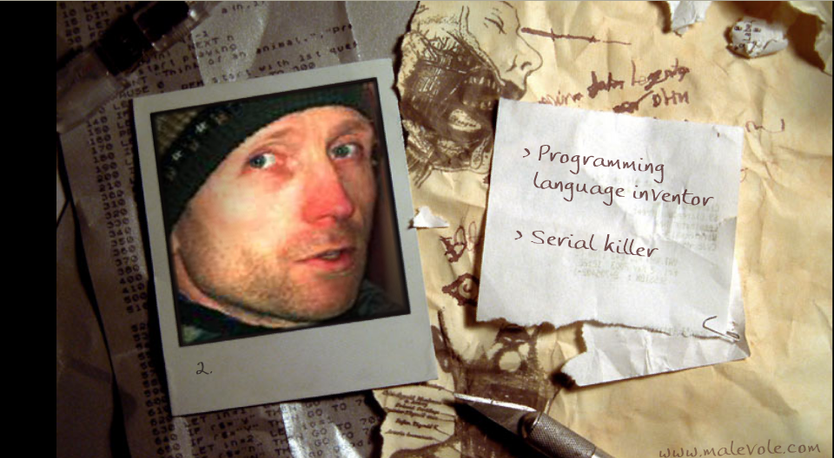
Your favorite game!
Notes:
The terminator wiped out entire families across Ukraine at point-blank range with a 12-gauge shotgun “to me, killing people is like ripping up a duvet.”

Slide 30

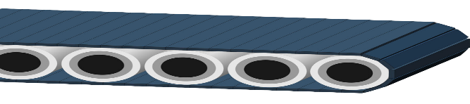



Queues What’s the big picture?
A queue is a super-useful* data structure that resembles a conveyer belt of dishes.
Dishes are added to the rear of the queue...
rear
front
rear
front
10
14
8
10
14
8
and dishes are extracted from its front...
rear
front
rear
front
Uses:
Use queues for vehicle navigation, implementing twitter feeds, queueing songs on Spotify, etc.
10
14
8
10
14
The first-in/first-out property of queues is opposite of the last-in-first-out property of stacks.
Notes:
Just like a stack of plates, you can only access the top plate/value, and every plate/value you add must go on the top.

Slide 31
Another ADT: The Queue
The queue is another ADT that is just a like a line at the store or at the bank.
The first person in line is the first person out of line and served.
This is called a FIFO data structure:
FIRST IN, FIRST OUT.
Every queue has a front and a rear. You enqueue items at the rear and dequeue from the front.
rear
front
4
17
5
4 –3
-3
17
What data structures could you use to implement a queue?

Slide 32
The Queue Interface
void enqueue(int a):
Inserts an item on the rear of the queue
int dequeue():
Removes and returns the top item from the front of the queue
bool isEmpty():
Determines if the queue is empty
int size():
Determines the # of items in the queue
int getFront():
Gives the value of the top item on the queue without removing it like dequeue
Like a Stack, we can have queues of any type of data! Queues of strings, Points, Nerds, ints, etc!

Slide 33
Common Uses for Queues
Often, data flows from the Internet faster than the computer can use it. We use a queue to hold the data until the browser is ready to display it...
Every time your computer receives a character, it enqueues it:
internetQueue.enqueue(c);
Every time your Internet browser is ready to get and display new data, it looks in the queue:
while (internetQueue.isEmpty() == false)
{
char ch = internetQueue.dequeue();
cout << ch; // display web page…
}

Slide 34
Common Uses for Queues
You can also use queues to search through mazes!
If you use a queue instead of a stack in our searching algorithm, it will search the maze in a different order…
Instead of always exploring the last x,y location pushed on top of the stack first…
The new algorithm explores the oldest x,y location inserted into the queue first.

Slide 35
Solving a Maze with a Queue!
(AKA Breadth-first Search)
sx,sy = 1,1
0 1 2 3 4 5 6 7
1. Insert starting point onto the queue.
2. Mark the starting point as “discovered.”
3. While the queue is not empty:
A. Remove the front point from the queue.
B. If we’re at the endpoint, DONE! Otherwise…
C. If slot to the WEST is open & is undiscovered
Mark (curx-1,cury) as “discovered”
INSERT (curx-1,cury) on queue.
D. If slot to the EAST is open & is undiscovered
Mark (curx+1,cury) as “discovered”
INSERT (curx+1,cury) on queue.
E. If slot to the NORTH is open & is undiscovered
Mark (curx,cury-1) as “discovered”
INSERT (curx,cury-1) on queue.
F. If slot to the SOUTH is open & is undiscovered
Mark (curx,cury+1) as “discovered”
INSERT (curx,cury+1) on queue.
?
?
?
0
1
2
3
4
5
6
7
?
?
?
?
?
?
?
#
#
#
#
?
?
?
?
?
#
#
// Use the queue to explore the maze
// (we’ll see how in a bit)
?
#
x
And so on…
curx,cury=
rear
front
4. If the queue is empty and we haven’t reached our goal position, then the maze is unsolvable.
(3,1)
(1,3)
(3,2)
(4,1)
(1,2)
(1,1)
(2,1)

Slide 36
Solving a Maze with a Queue Breadth-first Search Visualization
Watch how the squares we explore expand out like ripples in a pond…
0 1 2 3 4 5 6 7
0
1
2
3
4
5
6
7
start
#
#
#
#
#
#
It does this because each new square to explore is added to the END of the queue…
#
#
#
#
#
#
#
So squares closer to the starting square are explored before squares further away.
#
#
#
#
goal
#
This is why it’s called a “breadth-first” search.

Slide 37
Queue Implementations
We can use an array and an integer to represent a queue:
int queue[6], rear = 0;
rear
2
2
1
queue
3
6
6
0
5
9
9
0 1 2 3 4 5
0
Every time you insert an item, place it in the rear slot of the array and increment the rear count
Every time you dequeue an item, move all of the items forward in the array and decrement the rear count.
What’s the problem with the array-based implementation?
If we have N items in the queue, what is the cost of: (1) inserting a new item, (2) dequeuing an item

Slide 38
Queue Implementations
We can also use a linked list to represent a queue:
Every time you insert an item, add a new node to the end of the linked list.
Every time you dequeue an item, take it from the head of the linked list and then delete the head node.
Of course, you’ll want to make sure you have both head and tail pointers…
or your linked-list based queue will be really inefficient!

Slide 39
The Circular Queue
The circular queue is a clever type of array-based queue.
Unlike our previous array-based queue, we never need to shift items with the circular queue!
X
queue
6
6
5
9
9
0 1 2 3 4 5
Let’s see how it works!

Slide 40
The Circular Queue
If the count is zero, then you know the queue is empty. If the count is N, you know it’s full…
H
Private data:
an array: arr
an integer: head
an integer: tail
an integer: count
T
0 1 2 3 4 5
6
42
4
-1
9
7
5
0
5
4
1
2
3
tail
2
head
1
3
1
6
4
-1
0 0
0
count
3
4
5
2
4
3
4
3
2
1
To initialize your queue, set:
count = head = tail = 0
Enqueue: 6
Enqueue: 4
To insert a new item, place it in arr[tail] and then increment the tail & count values
Enqueue: -1
Dequeue -> 6
Enqueue: 9
To dequeue the head item, fetch arr[head] and increment head and decrement count
Enqueue: 7
Dequeue -> 4
Enqueue: 5
If the head or tail go past the end of the array, set it back to 0.
Enqueue: 42
Dequeue -> -1

Slide 41
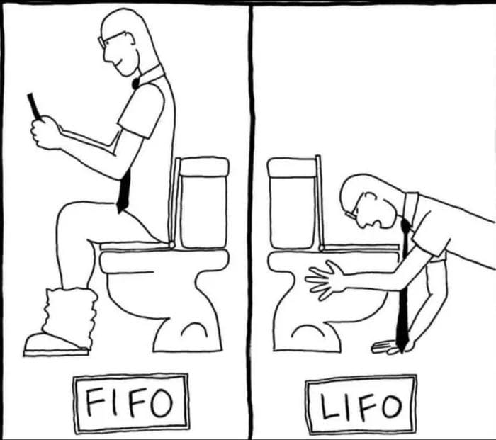
To help you remember…
Queue
Stack

Slide 42
A Queue in the STL!
The people who wrote the Standard Template Library also built a queue class for you:
#include <iostream>
#include <queue>
int main()
{
std::queue<int> iqueue; // queue of ints
iqueue.push(10); // add item to rear
iqueue.push(20);
cout << iqueue.front(); // view front item
iqueue.pop(); // discard front item
if (iqueue.empty() == false)
cout << iqueue.size();
}

Slide 43
Class Challenge
Given a circular queue of 6 elements, show the queue’s contents, and the Head and Tail pointers after the following operations are complete:
enqueue(5)
enqueue(10)
enqueue(12)
dequeue()
enqueue(7)
dequeue()
enqueue(9)
enqueue(12)
enqueue(13)
dequeue()
Notes:
Queue looks like this initially:
_ _ _ _ _ _
Step 1:
5 _ _ _ _ _
H T
Step 2:
5 10 _ _ _ _
H T
Step 3:
5 10 12 _ _ _
H T
Step 4:
_ 10 12 _ _ _
H T
Step 5:
_ 10 12 7 _ _
H T
Step 6:
_ _ 12 7 _ _
H T
Step 7:
_ _ 12 7 9 _
H T
Step 8:
_ _ 12 7 9 12
T H
Step 9:
13 _ 12 7 9 12
T H
Step 10:
13 _ _ 7 9 12
T H
Note that technically whenever we dequeue, the slot that we dequeue from will actually keep the item that it had, but the Tail pointer will wraparound and eventually overwrite that original value if we keep enqueuing.
In my answer, I made slots appear empty if they had been dequeued, but that’s more for illustrative purposes.
Try out the same example, but leave the original items in their slots, even after they’re dequeued. Make sure to keep moving the Head and Tail pointers though whenever it’s necessary to do so.
What you’ll see is that the dequeued slots will never be referred to again and when the Tail pointer wraps around, we will just fill in new enqueued values.
Throughout the process of enqueuing and dequeing, all the pertinent values of the circular queue will be within a region bounded by Head and Tail, or Tail and Head, respectively.

